Slide 1


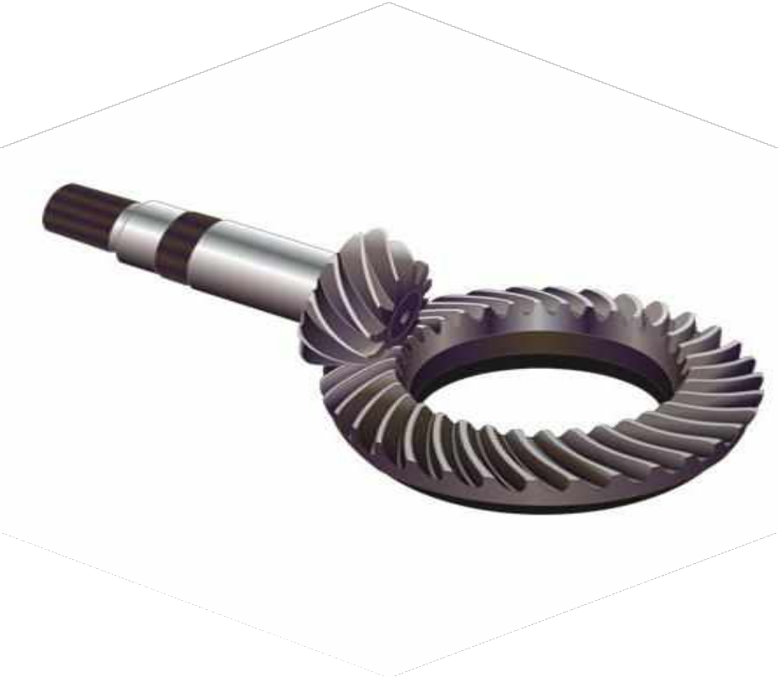



Vishwakarma Institute of Information Technology
Department of Mechanical Engineering
INDIA
Internship period 03/01/24 to 02/07/24
AUTOMATION OF
CWP LINE
I n d u s t r y M e n t o r
M R . P. S . K U M AWAT
P r e p a r e d B y : -
A D N A N M . K AT K AT I
2 2 1 2 0 2 7 3
7/10/2024
Rear Axle

Slide 2
TAILSTOCK BASEPLATE DESIGN
RAL 395 M/C

Slide 3


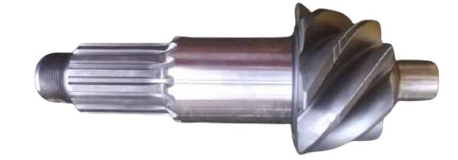
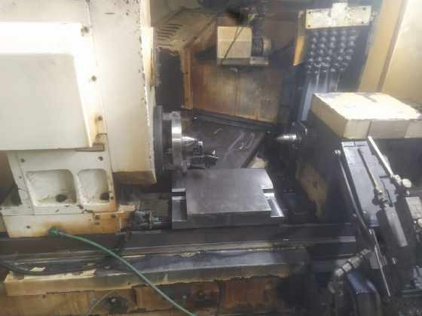
PROBLEM STATEMENT
FR
High rejection due to burning mark / excess material removal, undersize, taper
Play in tail stock spindle unit, worn-out bushes
The tailstock cannot be modified further so it is required to replace the tailstock.
Here we are reusing old available tailstock to replace existing one with some modifications.
Big & Small Diameter Grinding
m/c

Slide 4
FISHBONE DIAGRAM
FR
MAN
MACHINE
Speed work on M/C
Trainee or unskilled
operator
Negligence of process
Play in guide ways
M/C center problem
Excessive play in TTaaiillssttoocckk
Play in taper setting
•• VVaarriiaattiioonn iinn hhyyddrraauulliicc pressure
Drive pinion,
Excess material removal
Undersize
Taper
Hardness
Wire shots on center
Dresser problem
DP center problem
Coolant oil not ok
By pass of dressing
Setting properly not done
Shop floor issue
Not using Gauge properly
MATERIAL
METHOD

Slide 5

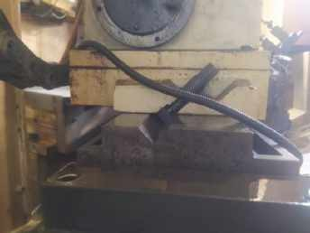
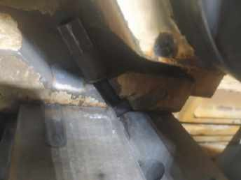
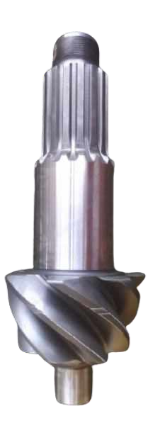
DATA COLLECTION
FR
Bed and lock nut
Required shape
Effect of miss-aligned centers on shape

Slide 6
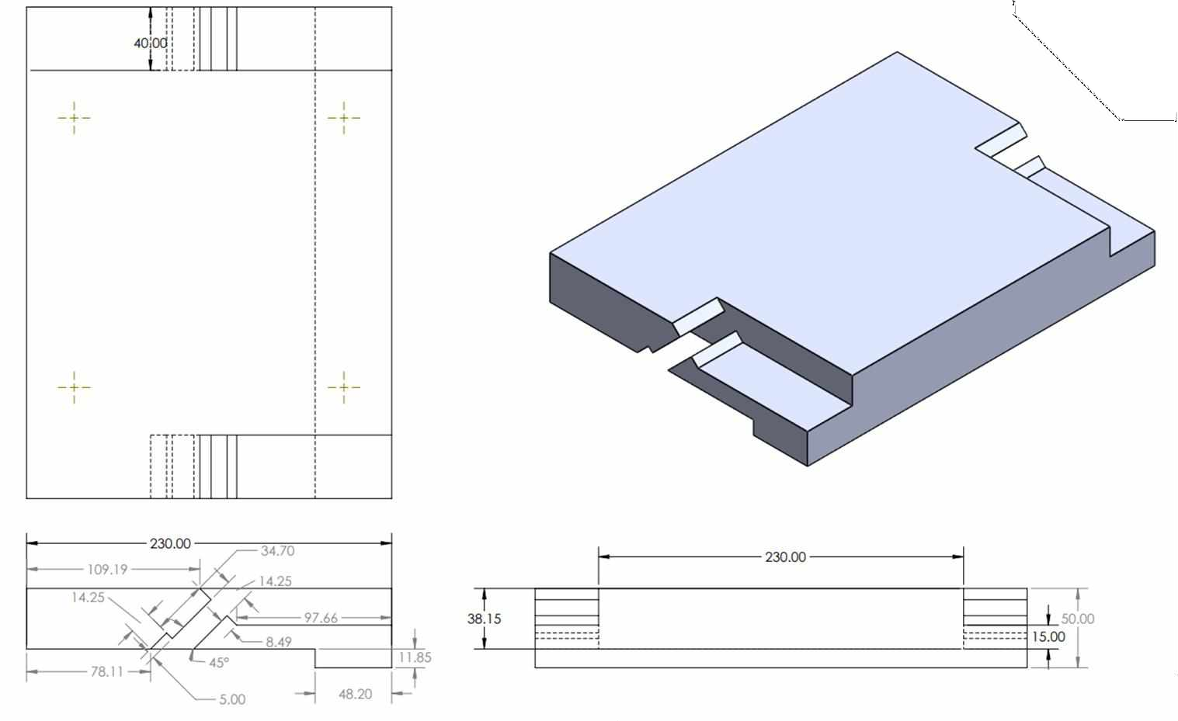
BASEPLATE DESIGN
FR

Slide 7
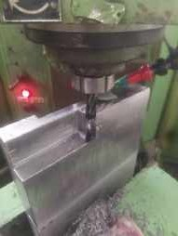
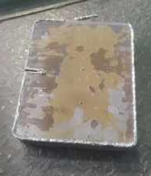
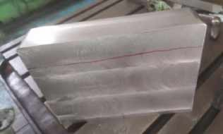
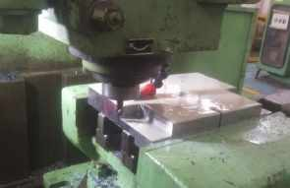
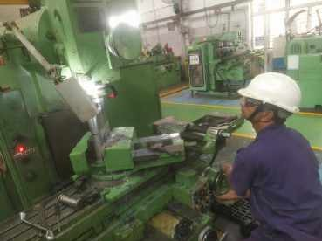
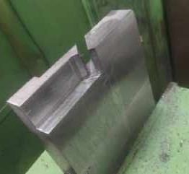
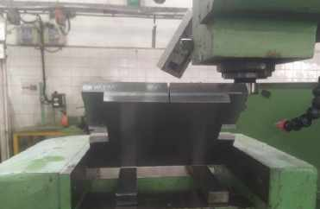
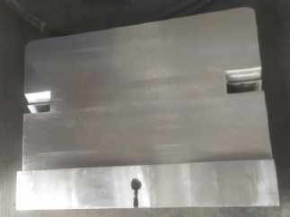
MANUFACTURING AND IMPLEMENTATION
FR
STEP 1
Blank
STEP 2
Milling operation
STEP 3
Side rectangular slots
STEP 4
Inclined slot at 45º
STEP 5
45º inclination cut
STEP 6
T head slot
STEP 7
Material filling at center

Slide 8
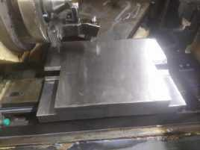
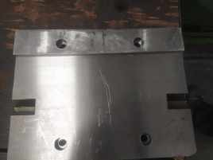
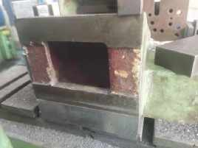
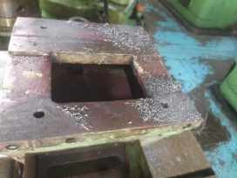
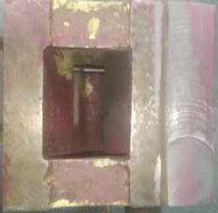
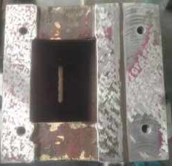
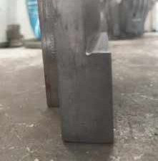
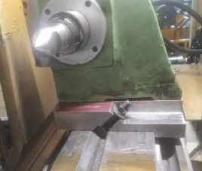
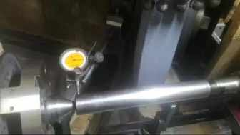
MANUFACTURING AND IMPLEMENTATION
FR
STEP 8
Alignment of plate with
STEP 9
Drilling on base plate
STEP 10
Butting portion removal
STEP 11
Drilling and tapping
bed
Before | STEP 12 |  | After
STEP 13
Grooving at butting face
STEP 14
Assembly
STEP 15
Alignment checking
Contact Check

Slide 9

THANK YOU!

